Slide 1
Methods and Classes
Restricting access to a class’ members is a fundamental part of object-oriented programming because it helps prevent the misuse of an object.
By allowing access to private data only through a well-defined set of methods, you can prevent improper values from being assigned to that data—by performing a range check, for example.
It is not possible for code outside the class to set the value of a private member directly.

Slide 2

Methods and Classes
Member access control is achieved through the use of three access modifiers: public, private, and protected.
When a member of a class is modified by the public specifier, that member can be accessed by any other code in your program. This includes by methods defined inside other classes.
When a member of a class is specified as private, that member can be accessed only by other members of its class. Thus, methods in other classes cannot access a private member of another class.

Slide 3
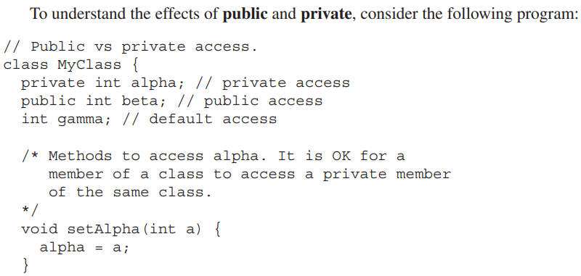
Methods and Classes

Slide 4
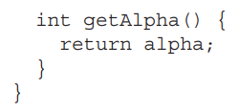
Methods and Classes

Slide 5
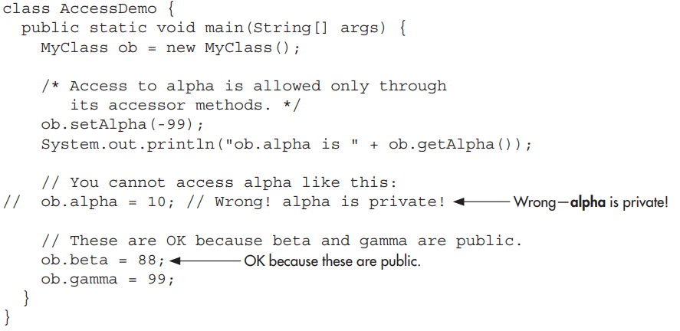
Methods and Classes

Slide 6
Methods and Classes
To see how access control can be applied to a more practical example, consider the following program that implements a “fail-soft” int array, in which boundary errors are prevented, thus avoiding a run-time exception from being generated.
This is accomplished by encapsulating the array as a private member of a class, allowing access to the array only through member methods.

Slide 7

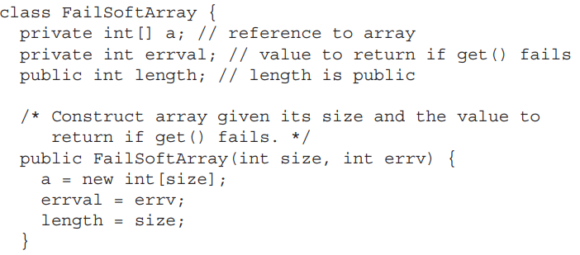
Methods and Classes

Slide 8
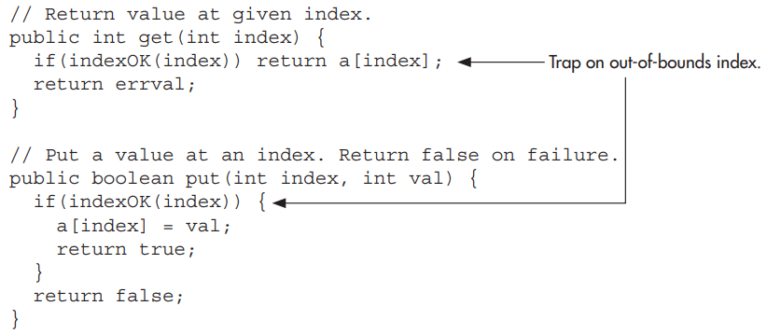
Methods and Classes

Slide 9
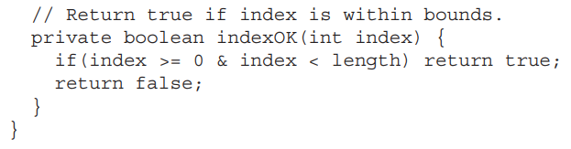
Methods and Classes

Slide 10
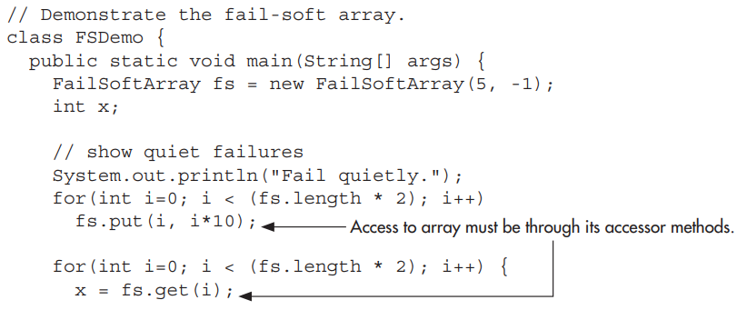
Methods and Classes

Slide 11
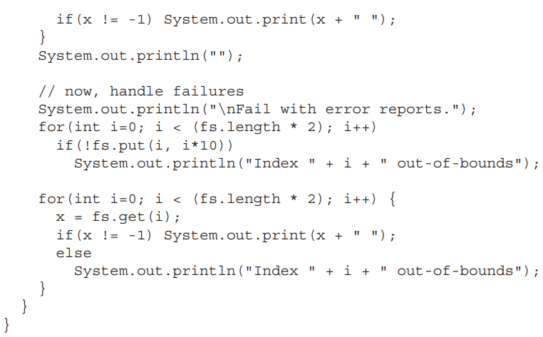
Methods and Classes

Slide 12
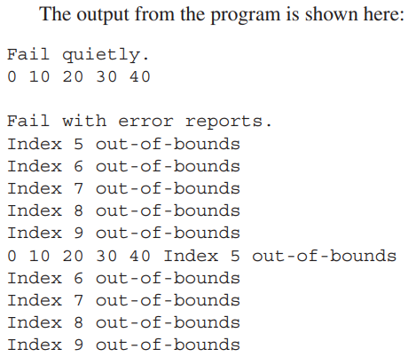
Methods and Classes

Slide 13

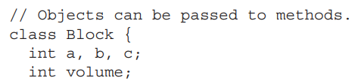
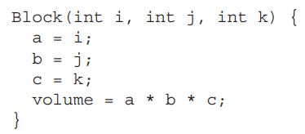
Methods and Classes

Slide 14
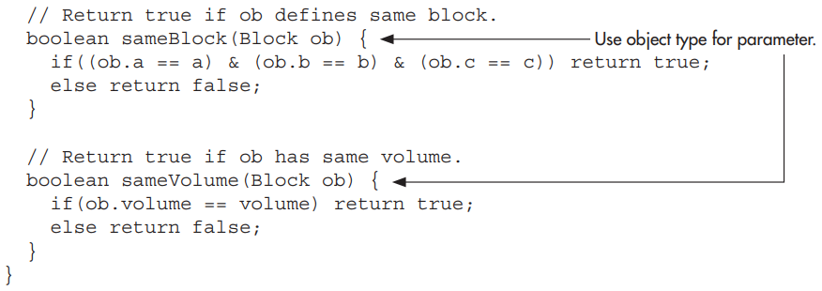
Methods and Classes

Slide 15
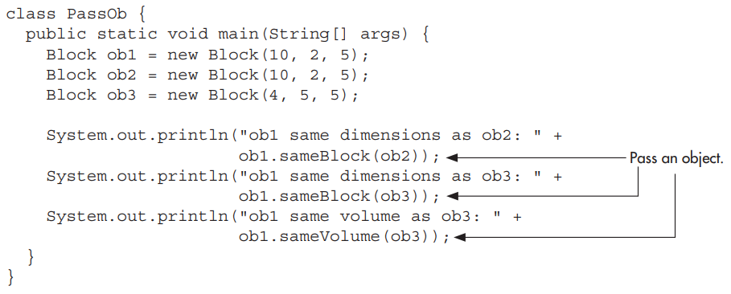
Methods and Classes

Slide 16
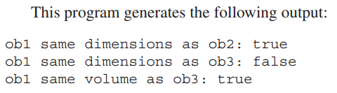
Methods and Classes

Slide 17

Methods and Classes
The first way is call-by-value. This approach copies the value of an argument into the formal parameter of the subroutine.
Therefore, changes made to the parameter of the subroutine have no effect on the argument in the call.

Slide 18
Methods and Classes
The second way an argument can be passed is call-by-reference.
In this approach, a reference to an argument (not the value of the argument) is passed to the parameter.
Inside the subroutine, this reference is used to access the actual argument specified in the call. This means that changes made to the parameter will affect the argument used to call the subroutine.

Slide 19
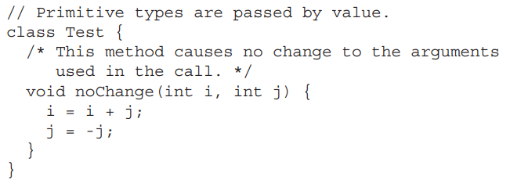
Methods and Classes

Slide 20
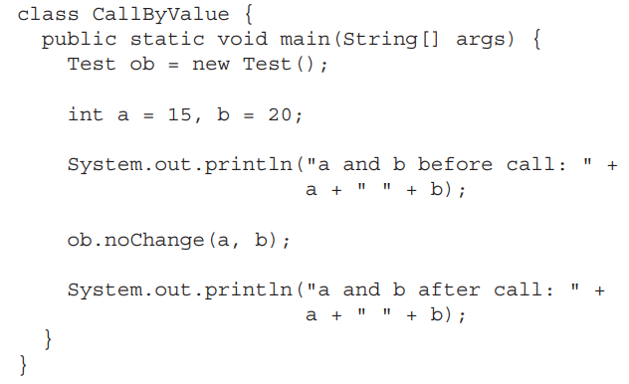
Methods and Classes

Slide 21
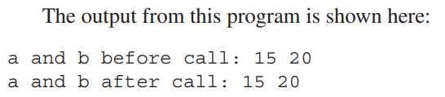
Methods and Classes

Slide 22
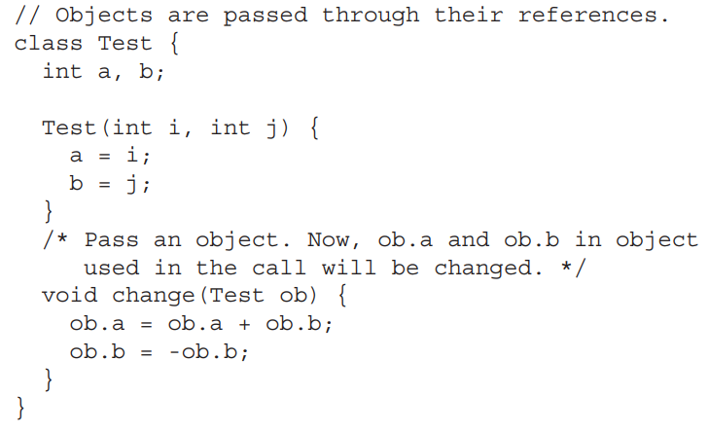
Methods and Classes

Slide 23
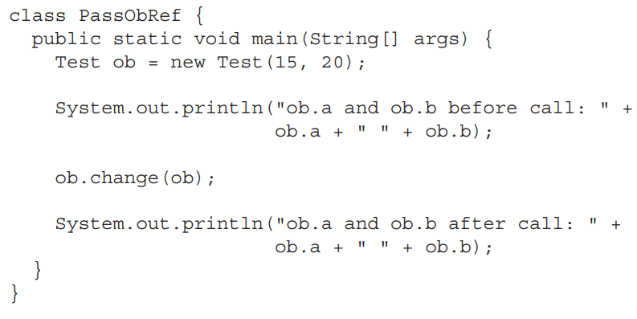
Methods and Classes

Slide 24
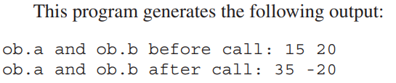
Methods and Classes

Slide 25

Methods and Classes
A method can return any type of data, including class types.
For example, the class ErrorMsg shown here could be used to report errors.

Slide 26
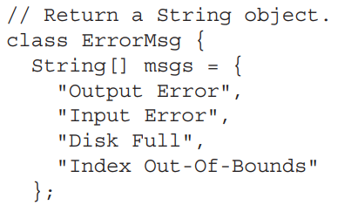
Methods and Classes

Slide 27
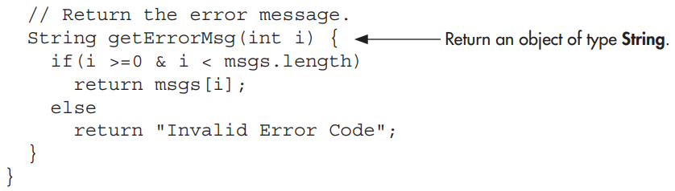
Methods and Classes

Slide 28

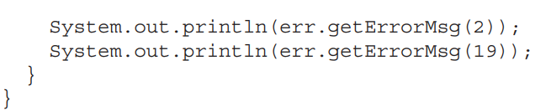
Methods and Classes

Slide 29
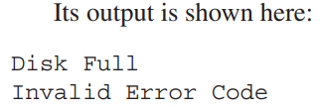
Methods and Classes

Slide 30

Methods and Classes
In Java, two or more methods within the same class can share the same name, as long as their parameter declarations are different.
When this is the case, the methods are said to be overloaded, and the process is referred to as method overloading.
Method overloading is one of the ways that Java implements polymorphism.

Slide 31
Methods and Classes

